Slide 1

“Design of a fingerprint based payment system and it's implementation on FPGA”
DEPARTMENT OF VLSI DESIGN AND TECHNOLOGY (ELECTRONICS ENGINEERING )
Academic Year 2025-26
CHANNAYYA V METI : 1MJ23VL004
JEEVAN K HOSAKERI : 1MJ23VL011
CHETAN TORGALMATH : 1MJ23VL005
NARENDAR T RATHOR : 1MJ24VL406
Under the Guidance of
DR. SHENBHAGA LAKSHMI
Professor, Department of ELECTRONICS COMMUNICATION ENGINEERING
MVJ College of Engineering, Bangalore
Approved by AICTE |Affiliated to VTU | Recognized by UGC with 2(f) & 12(B) status |Accredited by NBA and NAAC

Slide 2
Contents
Introduction
Literature Review
Problem Statement
Existing system
Proposed System
Block Diagram
Flow chart
Verilog Code
Testbench Code
Components and software And Hardware Implementation
Simulation of Code
Contribution
Conclusion
References

Slide 3
Abstract
The project develops a secure cashless transaction system using fingerprint recognition to replace vulnerable PIN/password methods.
Fingerprints are scanned, unique features extracted, and matched against a secure pre-registered database for authentication.
The system has two main processes: registration (fingerprint capture, feature extraction, template storage) and transaction (live scan matched with stored template).
This biometric approach enhances security, reduces transaction time, and improves user experience compared to traditional methods.
It provides a proof-of-concept for a fast, reliable, and fraud-resistant payment system that minimizes unauthorized access.

Slide 4
OBJECTIVE
The rapid growth of digital payments has made life more convenient, but it has also led to a significant increase in financial fraud. Security is the biggest concern in cashless transactions. Current systems rely on knowledge-based factors like PINs or possession-based factors like cards, which can be easily compromised.
Biometrics offers a superior solution by using "who you are" as authentication. Fingerprints are an ideal biometric trait because they are unique to every individual and remain constant throughout a person's life. This project explores the use of fingerprint recognition to build a robust framework for securing cashless transactions.

Slide 5
LITERATURE REVIEW
Sl. No | Title | Authors | Publication & Year | Inference
1 |  | Bin.Rong, Chang-hua liu | International Conference Paper (Virtex-5 FPGA), 2024
A Fingerprint Payment System Based on FPGA
Proposes a complete offline fingerprint payment system using Xilinx Artix-7 FPGA (Basys-3 board). Integrates fingerprint module, VGA display, and PS/2 keyboard for account management, recharge, and payment. Achieved <1 sec average transaction time with FAR <0.001%. Shows FPGA feasibility for secure, convenient, low-cost offline payments

Slide 6
LITERATURE REVIEW
Sl.
No
Title
Authors
Publication & Year
Inference
Implementation of Fingerprint Recognition System on FPGA
2016 International Conference on Information System and Artificial Intelligence (IEEE)
Demonstrates complete fingerprint recognition pipeline (enhancement, thinning, minutiae extraction, matcher) Reports faster processing compared to software, with reduced latency. Highlights FPGA suitability for real-time biometric systems
2
S. Gayathri, et al.
Presents FPGA-based acceleration for fingerprint + iris recognition. Provides insights into parallelism, pipelining, and resource optimization. Useful to design secure, real-time, and scalable biometric payment systems with potential for multi-factor authentication
3
Hardware Architecture for Multimodal Biometric System on FPGA
T. M. Khan, et al.
arXiv preprint, 2022

Slide 7

LITERATURE REVIEW
Supports it's model as online cashless payment system which is based on biometric in Aadhaar card , as E-Payment system by providing security to the user banking transaction.
4
Fingerprint Biometric Based Online Cashless Payment System
Manjiri A , Pallavi K , Ankita R , Jaya S , Dr. Prapti Deshmukh
IOSR Journal of Computer , 2019
Biometric systems are increasingly replacing traditional password and token-based authentication system . Security and accuracy are the two most important aspects considered in the designing of biometric systems.
Security and Accuracy of Fingerprint-Based Biometric
Wencheng Yaung , Song Wang , Jiankun Hu , Craig Valli , Guanglou Zheng
5
MDPI , Jan 2019

Slide 8
LITERATURE REVIEW
Biometric Based Payment System
Banumathi KL, Shreyas P, S Suhas , Chitra A
(WJARR) World Journal Of Advanced Research And Reviews , July 2024
This presents biometric-based payment system designed on streamlined transaction while prioritizing security.
6
Payment Transaction Using Biometric Authentication
Arati S , Isha S , Gayatri G , Jayganesh N
(JETRI) Journal Of Emerging Technologies and Innovative Research , April 2024
Demonstrates the integration of biometric into platforms of payment to light their role in fighting frauds and simplifying the process of authentication
7

Slide 9
PROBLEM STATEMENT
To design and implement a secure cashless transaction system that utilizes fingerprint biometrics to overcome vulnerabilities associated with PINs, passwords, and OTPs. The system must accurately and quickly verify a user's identity to authorize a payment, preventing unauthorized access and fraudulent transactions.

Slide 10
EXISTING SYSTEM
Current transaction systems rely on methods that are susceptible to breaches:
PINs and Passwords: Forgotten, stolen, or brute-forced.
Magnetic Stripe Cards: Easily cloned.
EMV Chip Cards: Secure but still depend on PIN.
One-Time Passwords (OTPs): Vulnerable to SIM-swapping and phishing.
These systems place the burden of security on the user, which is a proven weakness

Slide 11
PROPOSED SYSTEM
Our system integrates a fingerprint scanner into payments:
1. Enrollment: Register fingerprint → secure digital template → linked to account.
2. Authentication: User scans fingerprint.
3. Verification: Extract features → compare with stored template.
4. Authorization: Approve/decline transaction.
Advantages: - Enhanced Security: Nearly impossible to forge.
Convenience: No PINs or cards needed.
Speed: Instant authentication.

Slide 12
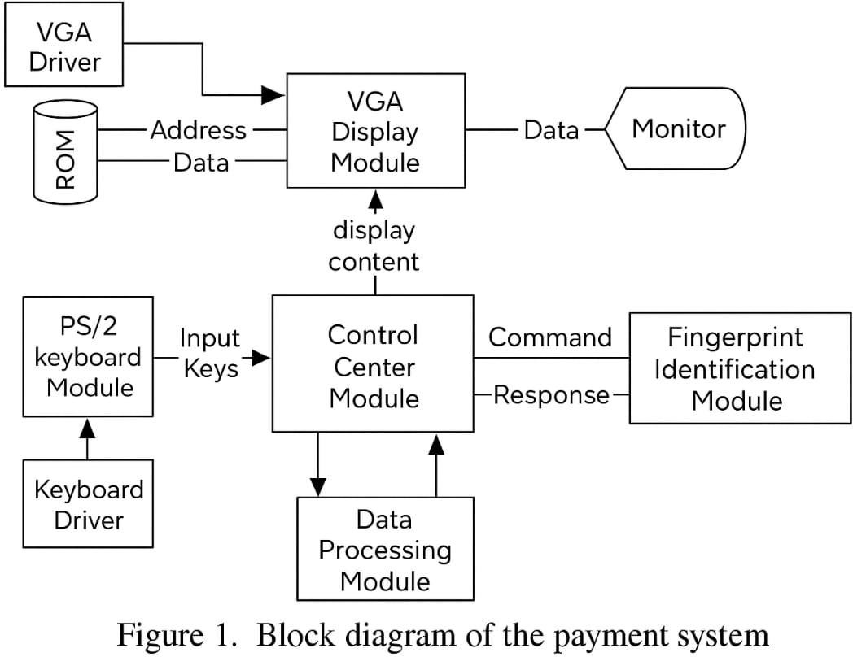
BLOCK DIAGRAM
Key modules:
Fingerprint Sensor: Captures high-resolution fingerprint image.
Feature Extraction Module: Identifies minutiae points.
Database: Encrypted storage of fingerprint templates.
Matching Engine: Compares live scan with stored templates.
Transaction Authorization System: Approves verified transactions.

Slide 13
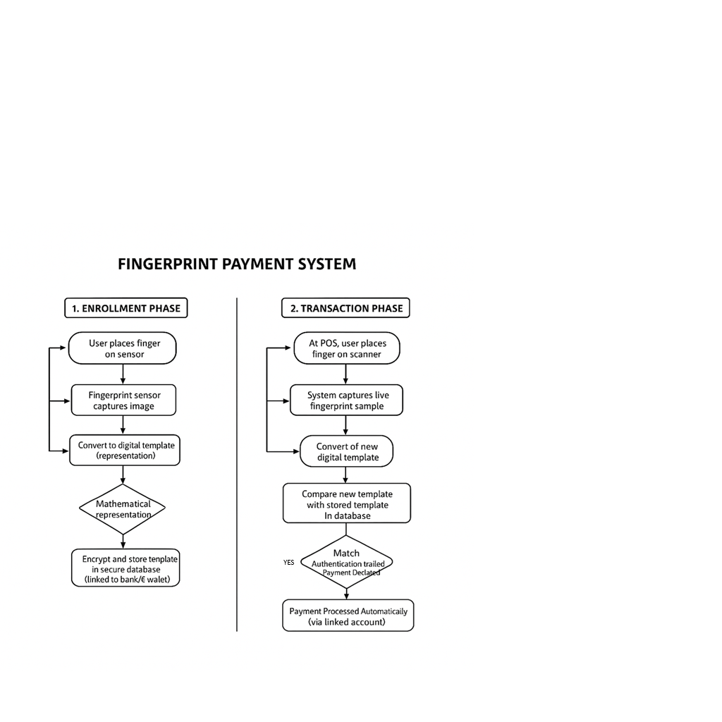
FLOW CHART

Slide 14
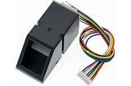
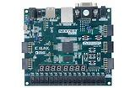

COMPONENTS:-
COMPONENTS | PURPOSE
AS608 Optical Fingerprint Sensor | Captures the fingerprint image of the user during registration and at the time of payment.
ARTIX-7 FPGA BOARD | Acts as the main control unit; performs fingerprint processing, matching, and controls communication with other modules.
SYSTEM USED | Shows messages like “Place Finger,” “Payment Successful,” or “Access Denied.” Allows user input such as entering payment amount or ID (optional). External system that processes payment after receiving verification from FPGA

Slide 15
SOFTWARE USED
SOFTWARE | PURPOSE
VERILOG CODE | Implements control logic in FPGA
Fingerprint Matching Algorithm | Verifies fingerprint identity.
Database Management Software | Stores templates and payment records.
Encryption and Security Module | Protects biometric and financial data.
User Interface | Displays transaction and user info.

Slide 16

TESTBENCH CODE
// tb_fingerprint_payment.v
`timescale 1ns/1ps
module tb_fingerprint_payment;
parameter TEMPLATE_W = 128;
parameter SLOTS = 8;
parameter THRESHOLD = 4;
reg clk;
reg rst_n;
// IO
reg enroll_valid;
reg [TEMPLATE_W-1:0] enroll_template;
reg tx_valid;
reg [TEMPLATE_W-1:0] tx_template;
wire enroll_ack;
wire tx_processing;
wire tx_approved;
wire tx_declined;
wire [$clog2(SLOTS)-1:0] matched_slot;
fingerprint_payment #(
.TEMPLATE_W(TEMPLATE_W),
.SLOTS(SLOTS),
.THRESHOLD(THRESHOLD)
) DUT (
.clk(clk), .rst_n(rst_n),
.enroll_valid(enroll_valid), .enroll_template(enroll_template),
.enroll_ack(enroll_ack),
.tx_valid(tx_valid), .tx_template(tx_template),
.tx_processing(tx_processing),
.tx_approved(tx_approved), .tx_declined(tx_declined),
.matched_slot(matched_slot)
);
// clk
initial clk = 0;
always #5 clk = ~clk; // 100MHz-ish in sim scale

Slide 17
TESTBENCH CODE
$display("Enroll ack? %0d", enroll_ack);
$display("=== TEST: Enroll slot1 ===");
enroll_template = 128'hFFFFFFFF00000000FFFFFFFF00000000; // sample 2
enroll_valid = 1;
#10;
enroll_valid = 0;
#50;
$display("=== TEST: Transaction match (exact) ===");
tx_template = 128'hA5A5A5A5A5A5A5A5A5A5A5A5A5A5A5A5; // exact match to slot0
tx_valid = 1;
#10;
tx_valid = 0;
// Wait until system finishes
wait (!tx_processing);
#10;
initial begin
rst_n = 0;
enroll_valid = 0;
enroll_template = 0;
tx_valid = 0;
tx_template = 0;
#20;
rst_n = 1;
#20;
$display("=== TEST: Enroll slot0 ===");
// Enroll a template (slot 0)
enroll_template = 128'hA5A5A5A5A5A5A5A5A5A5A5A5A5A5A5A5; // sample
enroll_valid = 1;
#10;
enroll_valid = 0;
#50;

Slide 18
TESTBENCH CODE
if (tx_approved) $display("Transaction APPROVED, matched_slot=%0d", matched_slot);
if (tx_declined) $display("Transaction DECLINED");
$display("=== TEST: Transaction approximate match (few bit differences) ===");
// flip a few bits within THRESHOLD
tx_template = 128'hA5A5A5A5A5A5A5A5A5A5A5A5A5A5A5A4; // 1-bit diff
tx_valid = 1;
#10;
tx_valid = 0;
wait (!tx_processing);
#10;
if (tx_approved) $display("Transaction APPROVED (approx), matched_slot=%0d", matched_slot);
if (tx_declined) $display("Transaction DECLINED");
$display("=== TEST: Transaction non-match ===");
tx_template = 128'h0123456789ABCDEF0123456789ABCDEF; // no match
tx_valid = 1;
#10;
tx_valid = 0;
wait (!tx_processing);
#10;
if (tx_approved) $display("Transaction APPROVED (unexpected), matched_slot=%0d", matched_slot);
if (tx_declined) $display("Transaction DECLINED (expected)");
$display("=== SIM END ===");
#50;
$finish;
end
endmodule

Slide 19
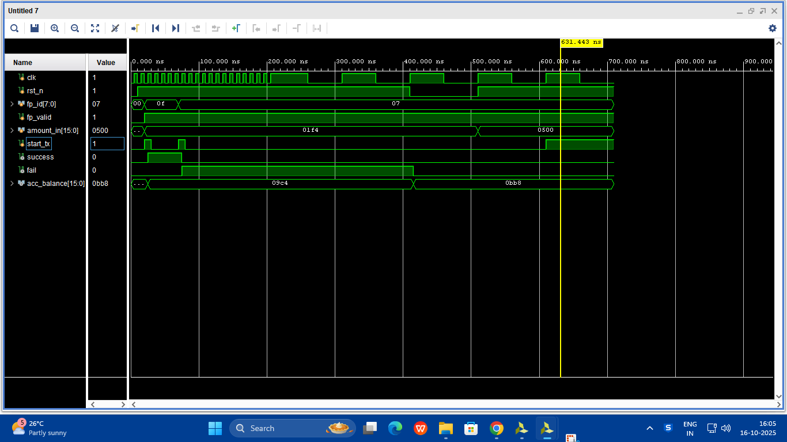
SIMULATION OF THE CODE
All operations are synchronized to clock
Fingerprint ID 07 is detected and passed into the system
System is active because reset =1(not in rest)
Failure Flag is Low- no error, transaction approved!!
fp_valid = 1 indicates fingerprint successfully verified
Transaction Completed Successfully!!
User Requests to deduct 500 units / amount
09C4(hex) = 9×256 + 12×16 + 4
= 2304 + 192 + 4
= 2500
Transaction begins when start_tx pluses HIGH
01F4(hex) = 1×256 + 15×16 + 4
= 256 + 240 + 4
= 500
Account Balance is Updated after successful transaction
0BB8 = 11×256 + 11×16 + 8
= 2816 + 176 + 8
= 2000

Slide 20
TIMELINE EXPLANATION
t0 – System running
  clk running
  rst_n = 1 → system active
t1 – Fingerprint is scanned
  fp_id = 07
  fp_valid = 1
  Means fingerprint matched
t2 – Transaction is initiated
  start_tx goes HIGH
  System begins processing
t3 – Balance Check
  amount_int = 0500
  acc_balance old value = 09C4 (2500)
  2500 – 500 = 2000
t4 – Transaction Approved
  success = 1
  fail = 0
  New balance updated to 0BB8 (2000)

Slide 21
VERILOG CODE
// Storage for templates (simple register file)
reg [TEMPLATE_W-1:0] template_mem [0:SLOTS-1];
reg [SLOTS-1:0] slot_used; // flag per slot
integer i;
// FSM states
typedef enum logic [2:0] {
IDLE,
ENROLL_STORE,
TX_SEARCH,
TX_DONE
} state_t;
state_t state, next_state;
// Internal search variables
reg [$clog2(SLOTS+1)-1:0] search_idx;
reg [TEMPLATE_W-1:0] xor_val;
reg [$clog2(TEMPLATE_W+1)-1:0] hamming_count; // counts set bits in xor
reg [$clog2(SLOTS+1)-1:0] best_match_idx;
reg match_found;
module fingerprint_payment #(
parameter TEMPLATE_W = 128,
parameter SLOTS = 8,
parameter THRESHOLD = 8)
(input wire clk,
input wire rst_n,
// Enrollment interface
input wire enroll_valid,
input wire [TEMPLATE_W-1:0] enroll_template,
output reg enroll_ack,
// Transaction interface
input wire tx_valid,
input wire [TEMPLATE_W-1:0] tx_template,
output reg tx_processing,
output reg tx_approved,
output reg tx_declined,
output reg [$clog2(SLOTS)-1:0] matched_slot
);

Slide 22
VERILOG CODE
state <= next_state;
// ack pulses: clear after one cycle
if (enroll_ack) enroll_ack <= 0;
if (tx_approved) tx_approved <= 0;
if (tx_declined) tx_declined <= 0;
end
end
// Next-state logic & main operations
always @(*) begin
// default next state
next_state = state;
case (state)
IDLE: begin
if (enroll_valid) next_state = ENROLL_STORE;
else if (tx_valid) next_state = TX_SEARCH;
end
ENROLL_STORE: begin
next_state = IDLE;
end
reg [$clog2(TEMPLATE_W+1)-1:0] pop_idx;
reg pop_running;
// reset / initialization
always @(posedge clk or negedge rst_n) begin
if (!rst_n) begin
enroll_ack <= 0;
tx_processing <= 0;
tx_approved <= 0;
tx_declined <= 0;
matched_slot <= {($clog2(SLOTS)){1'b0}};
slot_used <= {SLOTS{1'b0}};
for (i=0; i<SLOTS; i=i+1) template_mem[i] <= {TEMPLATE_W{1'b0}};
state <= IDLE;
search_idx <= 0;
pop_idx <= 0;
pop_running <= 0;
match_found <= 0;
best_match_idx <= 0;
end else begin

Slide 23
VERILOG CODE
// Enrollment store logic
always @(posedge clk) begin
if (!rst_n) begin
// handled in reset block above
end else begin
if (state == ENROLL_STORE) begin
// find first free slot
integer s;
enroll_ack <= 0;
for (s=0; s<SLOTS; s=s+1) begin
if (!slot_used[s]) begin
template_mem[s] <= enroll_template;
slot_used[s] <= 1'b1;
enroll_ack <= 1;
disable for; // end search after storing (non-synth friendly in some tools, but usually okay in Verilog simulation)
end
end
end
end
end
TX_SEARCH: begin
if (match_found) next_state = TX_DONE;
else if (search_idx == SLOTS) next_state = TX_DONE;
else next_state = TX_SEARCH; // stay until finished
end
TX_DONE: begin
next_state = IDLE;
end
default: next_state = IDLE;
endcase
end

Slide 24
VERILOG CODE
TX_SEARCH: begin
tx_processing <= 1;
// iterate until we examine all used slots
if (!pop_running) begin
// start popcount for current search_idx
if (search_idx < SLOTS) begin
if (slot_used[search_idx]) begin
xor_val <= template_mem[search_idx] ^ tx_template;
hamming_count <= 0;
pop_idx <= 0;
pop_running <= 1;
end else begin
// skip empty slot
search_idx <= search_idx + 1;
end
end else begin
// done scanning
search_idx <= search_idx; // remain
end
end else begin
always @(posedge clk or negedge rst_n) begin
if (!rst_n) begin
tx_processing <= 0;
search_idx <= 0;
pop_idx <= 0;
hamming_count <= 0;
pop_running <= 0;
match_found <= 0;
best_match_idx <= 0;
tx_declined <= 0;
tx_approved <= 0;
end else begin
case (state)
IDLE: begin
tx_processing <= 0;
search_idx <= 0;
pop_idx <= 0;
hamming_count <= 0;
pop_running <= 0;
match_found <= 0;
best_match_idx <= 0;

Slide 25
VERILOG CODE
// running popcount one bit each cycle
hamming_count <= hamming_count + xor_val[pop_idx];
pop_idx <= pop_idx + 1;
if (pop_idx + 1 == TEMPLATE_W) begin
// popcount done for this slot
pop_running <= 0;
// check threshold
if (hamming_count + xor_val[pop_idx] <= THRESHOLD) begin
match_found <= 1;
best_match_idx <= search_idx;
end else begin
// continue to next slot
search_idx <= search_idx + 1;
end
end
end
end
TX_DONE: begin
tx_processing <= 0;
if (match_found) begin
tx_approved <= 1;
matched_slot <= best_match_idx;
end else begin
tx_declined <= 1;
matched_slot <= {($clog2(SLOTS)){1'b0}};
end
end
default: begin
end
endcase
end
end
endmodule

Slide 26
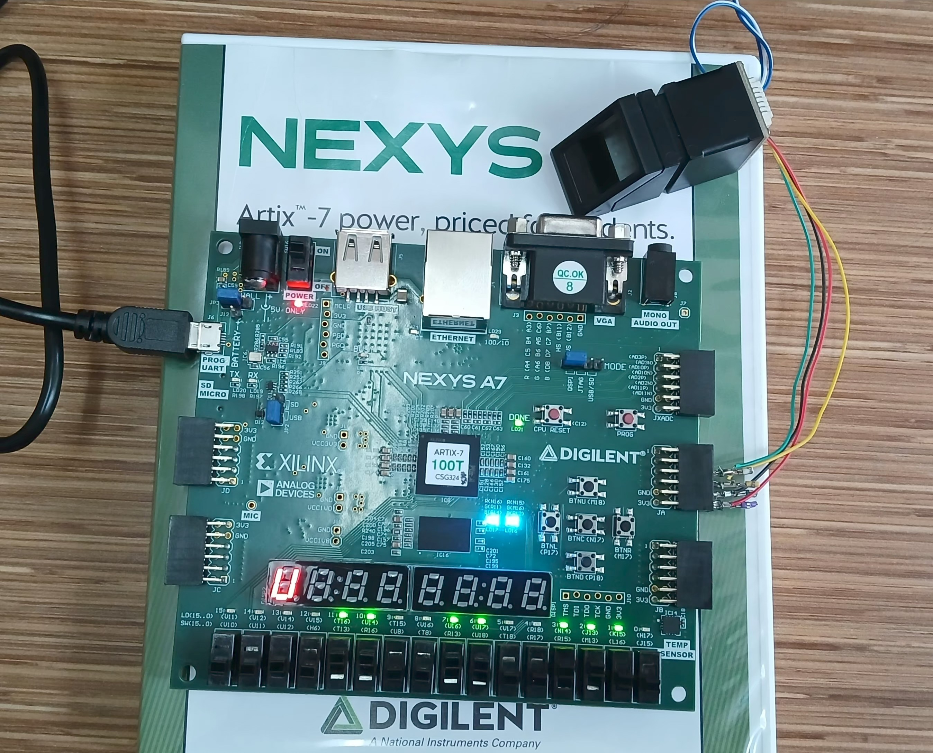
HARDWARE IMPLEMENTATION

Slide 27
CONTRIBUTIONS
CHANNAYYA V METI | CODE COMPILATION AND IMPLEMENTATION
JEEVAN K HOSAKERI | OUTPUT EXECUTION AND TESTING
CHETAN TORGALMATH | RESEARCH AND DATA COMPILATION
NARENDAR T RATHOR | CODE COMPILATION AND EXECUTION

Slide 28
CONCLUSION
This review has examined the transition from traditional payment methods to fingerprint-based biometric systems, driven by a strong need for enhanced security and user convenience.
In addition, the major obstacles to the widespread usage of this technology include significant security risks like sensor spoofing and template theft, and maintaining recognition accuracy in particular under non-ideal conditions. While database-centric systems and software-based systems do exist, they either demand constant connectivity or introduce software vulnerabilities.
The review of an FPGA-based system highlights a promising direction. Using "purely FPGA" to implement authentication and transaction logic, such a system holds the promise of being secure, highly efficient, low-cost, and offline-enabled.
In this, the hardware-centric design effectively bridges the gap between the high-security promise of biometrics and the practical demands of a fast, convenient, self-contained payment terminal.

Slide 29
REFERENCES
[1] Ogbanufe, O., & Kim, D. J. (2018). Comparing fingerprint-based biometrics authentication versus traditional authentication methods for e-payment. Decision Support Systems, 106, 1-14.
[2] Liébana-Cabanillas, F., Kalinic, Z., Muñoz-Leiva, F., & Higueras-Castillo, E. (2024). Biometric m-payment systems: A multi analytical approach to determining use intention. Information & Management, 61(2024), 103907.
[3] Yang, W., Wang, S., Hu, J., Zheng, G., & Valli, C. (2019). Security and Accuracy of Fingerprint-Based Biometrics: A Review. Symmetry, 11(2), 141.
[4] Nayak, A. S., Shetti, G. G., Shet, I., & Nayak, J. (2024). Payment Transaction Using Biometric Authentication. Journal of Emerging Technologies and Innovative Research (JETIR), 11(4), d639-d645.
[5] Lavadkar, M. A., Thorat, P. K., Kasliwal, A. R., Gadekar, J. S., & Deshmukh, P. (n.d.). Fingerprint Biometric Based Online Cashless Payment System. IOSR Journal of Computer Engineering(2023) (IOSR JCE), 27-32.
[6] Rong, B., & Liu, C. (2016). A Fingerprint Payment System Based on FPGA. 2016 International Conference on Information System and Artificial Intelligence (ISAI), 472-475.
[7] Logeswari, R., Saikoteswara, M., Sudheerkumar, M. V., & Suryateja, J. S. R. K. (2018). Fingerprint Based Online Payment System. International Research Journal of Engineering and Technology (IRJET), 5(10), 573-579.
[8] Banumathi, K. L., Shreyas, P., Suhas, S., Vyshnavi, H. K., & Chitra, A. (2024). Biometric based payment system. World Journal of Advanced Research and Reviews, 23(01), 1880-1892

Slide 30
THANK YOU

